Slide 2
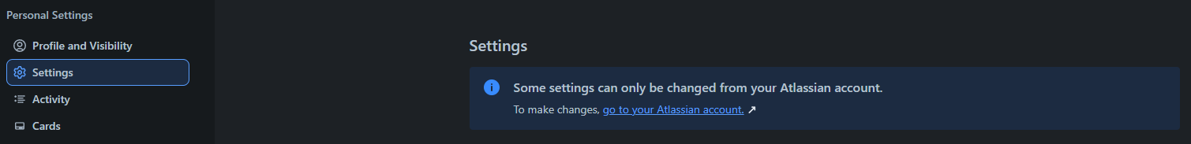



MAIN FUNCTIONALITY IN THE TRELLO SYSTEM
bbv Software Services AG | 21/07/2025

Slide 3
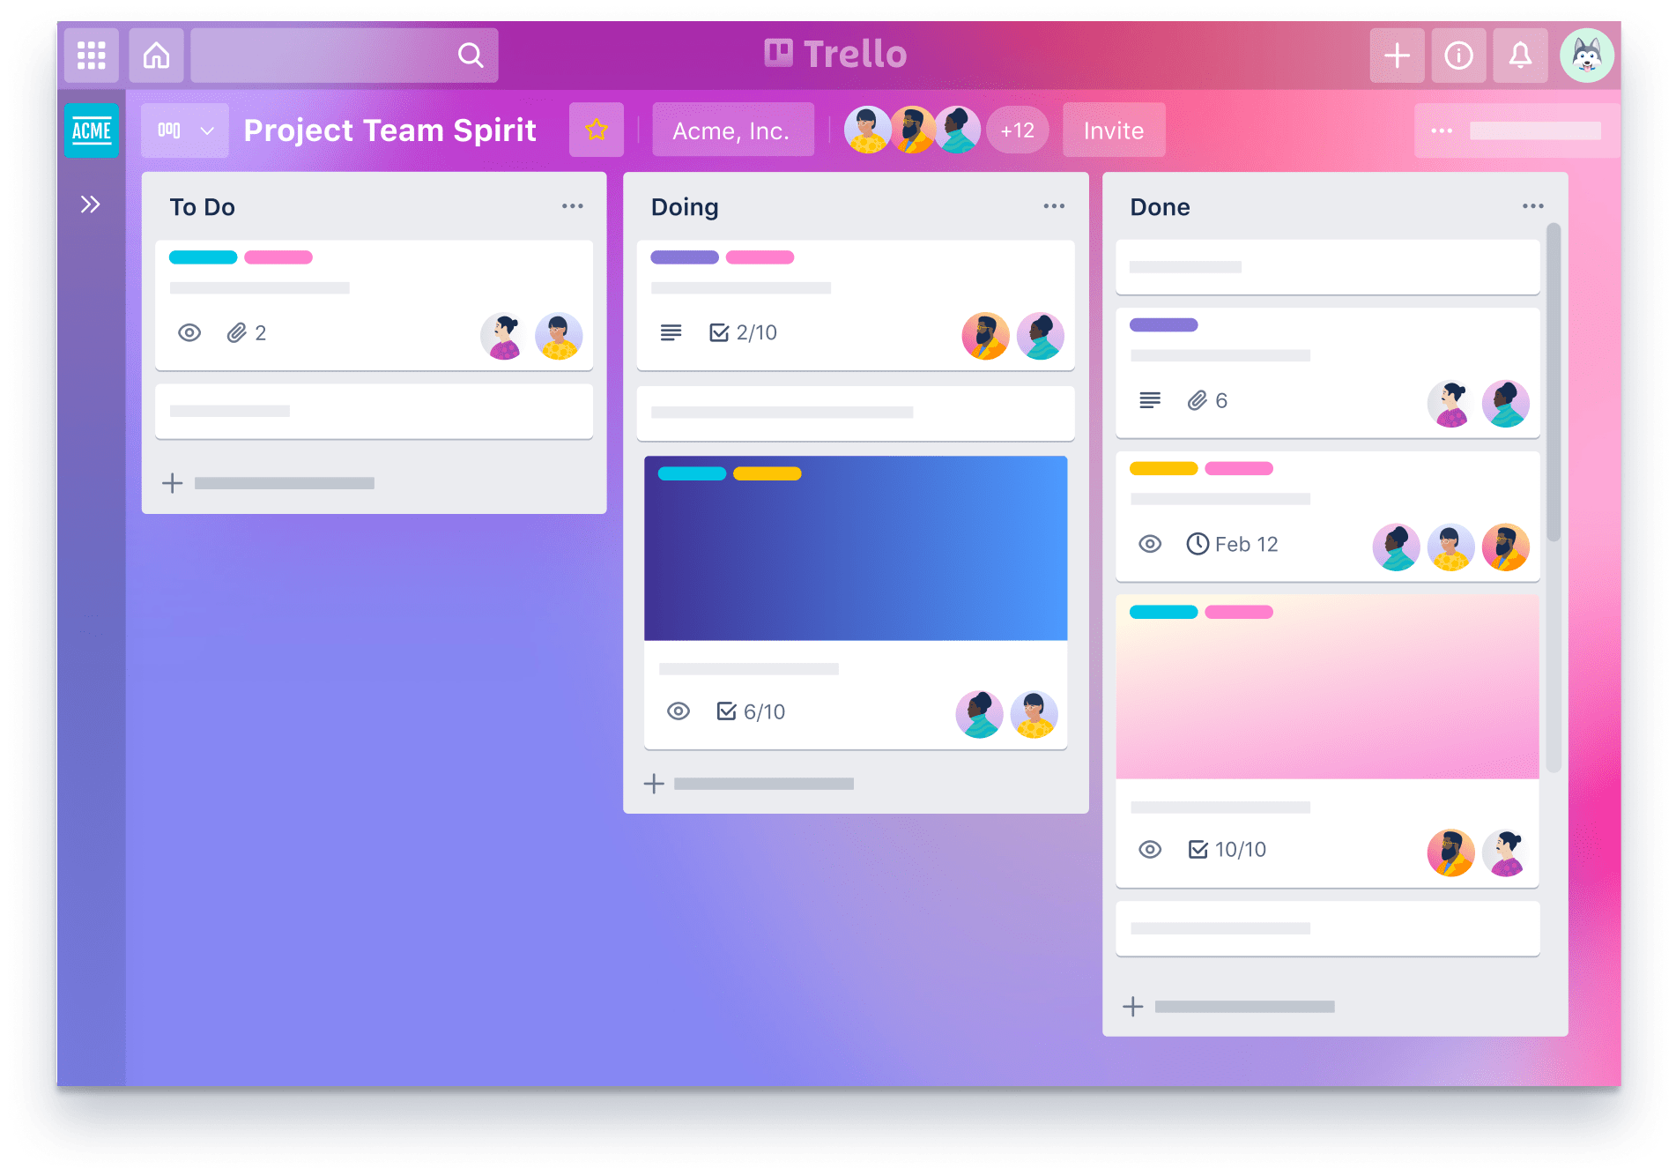
Agenda
Introduction to Functionality
UI in the Trello System
Entities in Trello System
Q&A

Slide 4
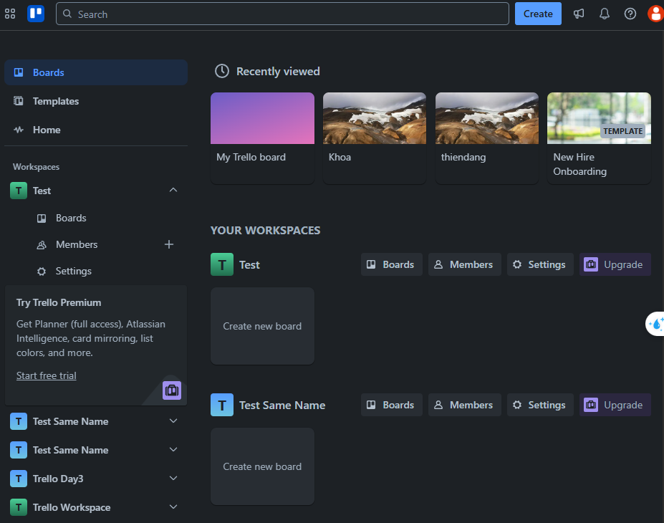
BOARDS TAB IN TRELLO SYSTEM
Board
Workspace
Notes:
Home Page Home Page Home Page on the Boards tab → Recently viewed section, list all boards that the user has accessed recently.
Home Page on the Boards tab → Your Workspaces section, list all workspaces that the current user is a member of.
Home Page on the Boards tab → Workspace item → Boards button, list all boards that the current user is a member of belonging to a specific workspace.
Home Page on the Header (top right corner), query boards have name that contains the keyword 'ab’
Home Page on the Header (top right corner), show the total number of unread notifications of the user.

Slide 5
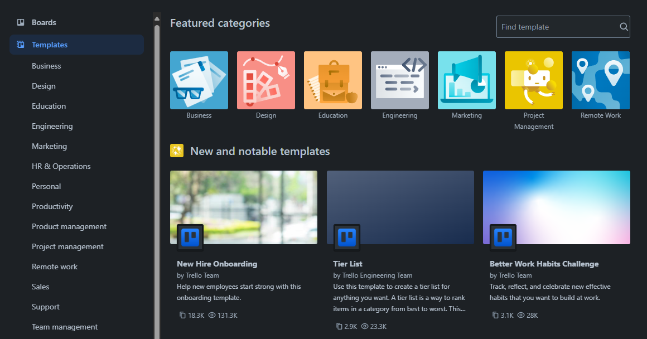
TEMPLATE TAB IN TRELLO SYSTEM
TemplateCategory
Template
Notes:
Home Page on the Templates tab → Main area, list all available public or user-created templates.
Home Page on the Templates tab → Sidebar, list all template categories available for filtering.
Home Page on the Templates tab, query templates have title that contains the keyword 'da'

Slide 6
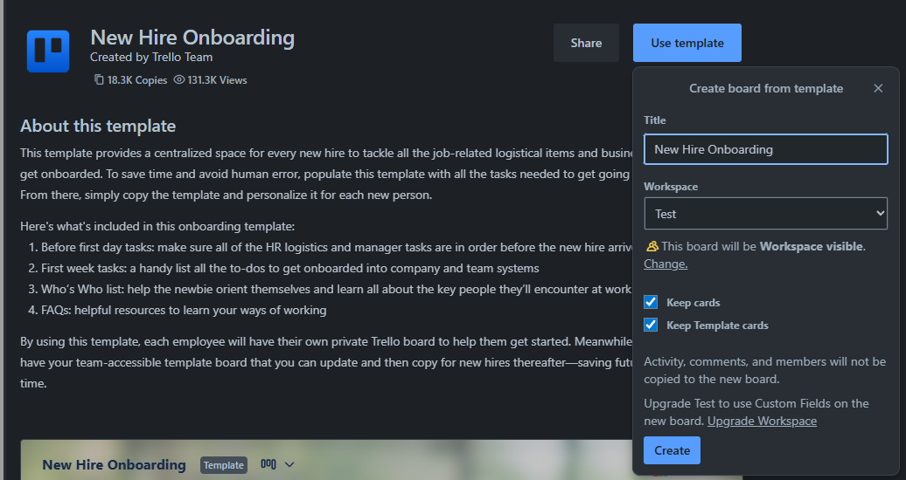
TEMPLATE IN TRELLO SYSTEM
Template
Board

Slide 7
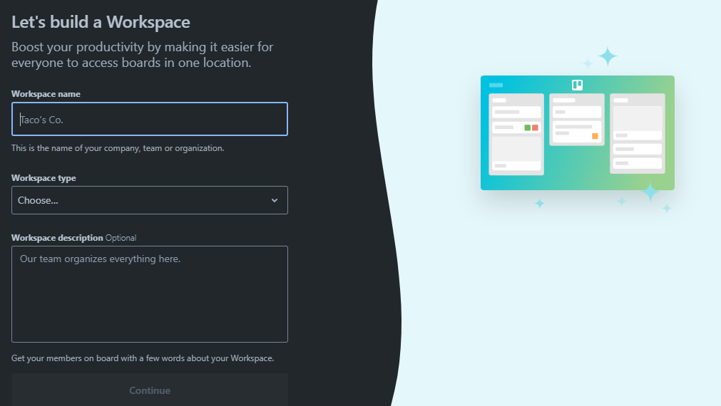
CREATE WORKSPACE IN TRELLO SYSTEM
Workspace Information

Slide 8
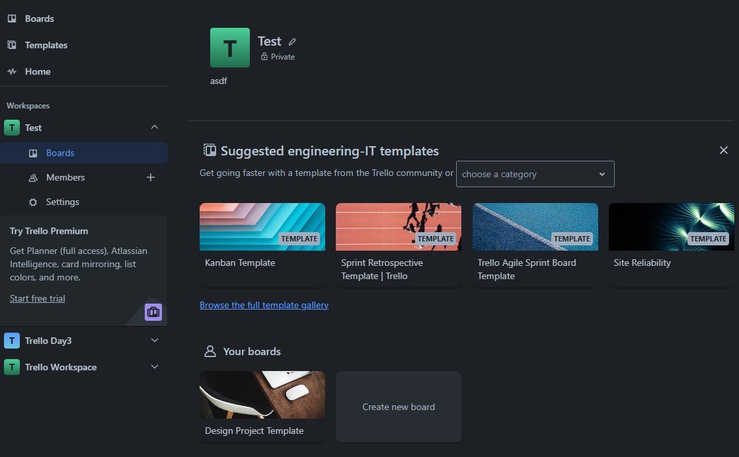
WORKSPACE IN TRELLO SYSTEM
Click here
Template
Board
Notes:
Home Page on the Boards tab → Workspace item → Boards button, list all boards that the current user is a member of belonging to a specific workspace.

Slide 9
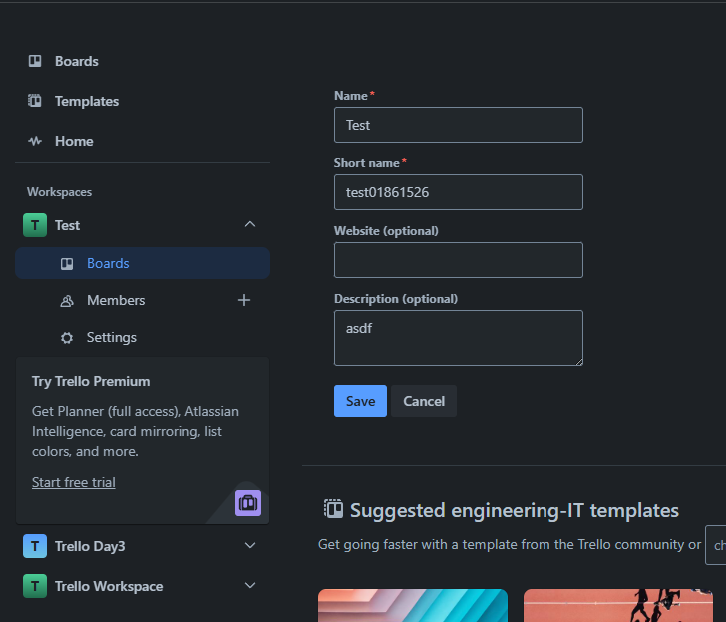
WORKSPACE IN TRELLO SYSTEM
Workspace Detail Information

Slide 10
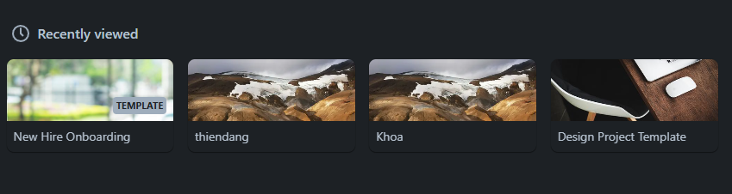
USERBOARDRECENTLYVIEW
IN TRELLO SYSTEM
UserBoardRecentlyView
Notes:
Home Page Home Page Home Page on the Boards tab → Recently viewed section, list all boards that the user has accessed recently.

Slide 11
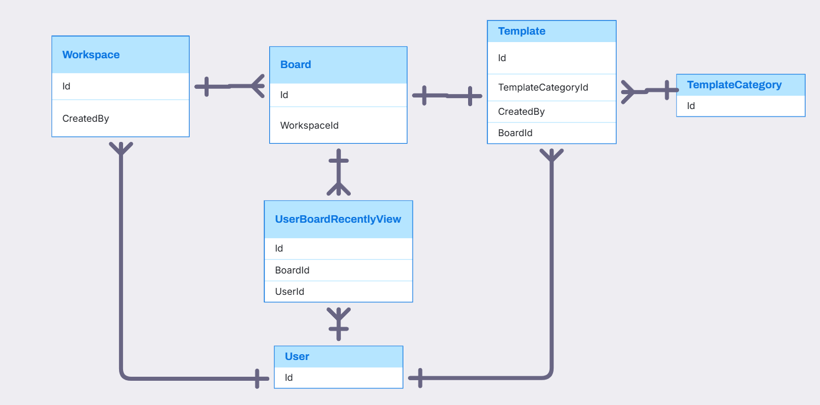
USER, WORKSPACE, BOARD, TEMPLATE, TEMPLATECATEGORY, USERBOARD RELATIONSHIP

Slide 12
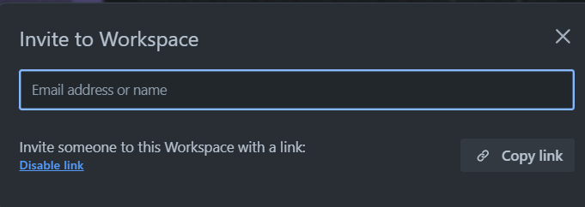
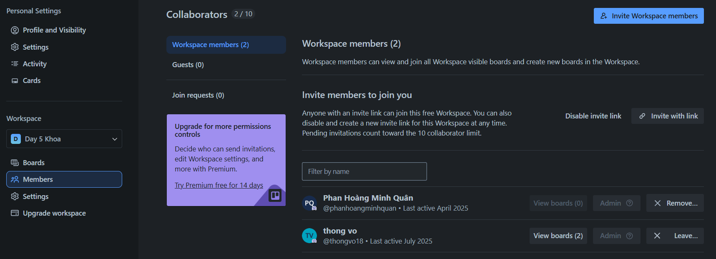
WORKSPACE IN TRELLO SYSTEM
ShareLink
Member
Permission
Notes:
Home Page on the Workspace page → Members section, list all members in the workspace along with their permission on roles.
Home Page on the Workspace page → Members section, count the total number of members in the selected workspace.

Slide 13
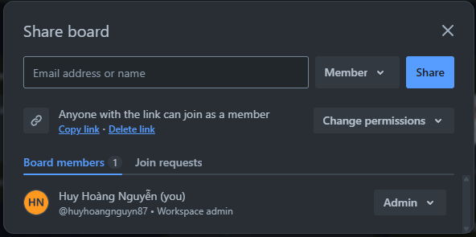
BOARD SHARE IN TRELLO SYSTEM
Add member to board with permission
Member Permission
Share link with permission
Notes:
Board Page on the Share Board pop-up, list all members in the board along with their permission on roles.

Slide 14
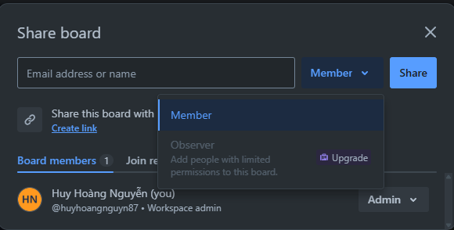
BOARD SHARE IN TRELLO SYSTEM
Permission code with admin, member, observer
Notes:
Board Page on the Share Board pop-up, list all members in the board along with their permission on roles.
Board Page on the Share Board pop-up, list all permission options can choose

Slide 15
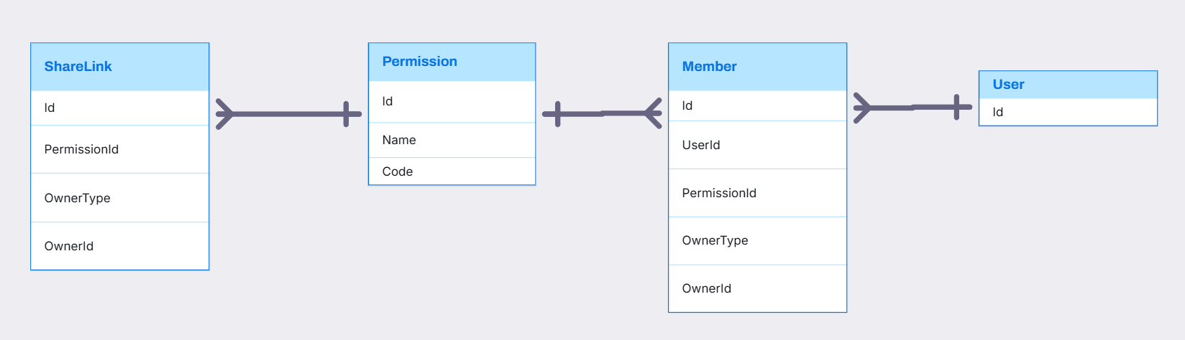
SHARELINK, PERMISSION, MEMBER RELATIONSHIP

Slide 16
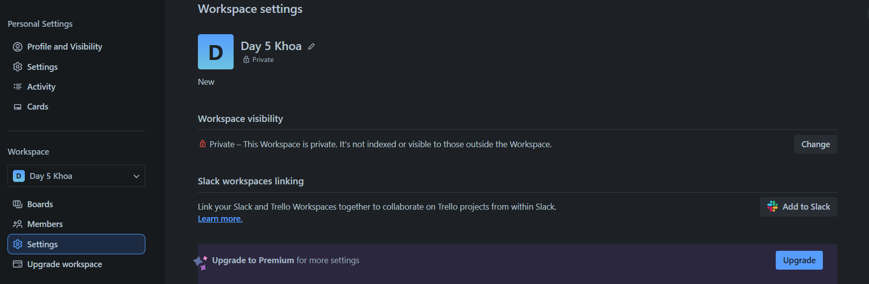
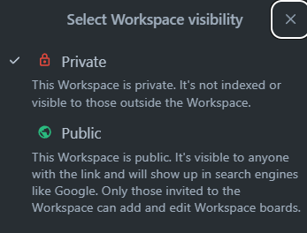
WORKSPACE SETTING IN TRELLO SYSTEM
SettingKey
SettingOption
SettingValue
Notes:
Home Page on the Workspace page → Settings section, list all workspace setting keys with the current user's selected values.
Home Page on the Workspace page → Settings section, list all settingoption of a specific workspace setting.

Slide 17
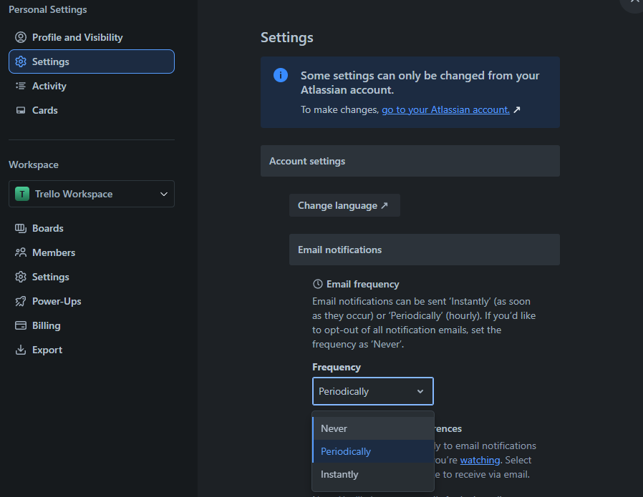
USER SETTING IN TRELLO SYSTEM
SettingKey
SettingValue
SettingOption

Slide 18
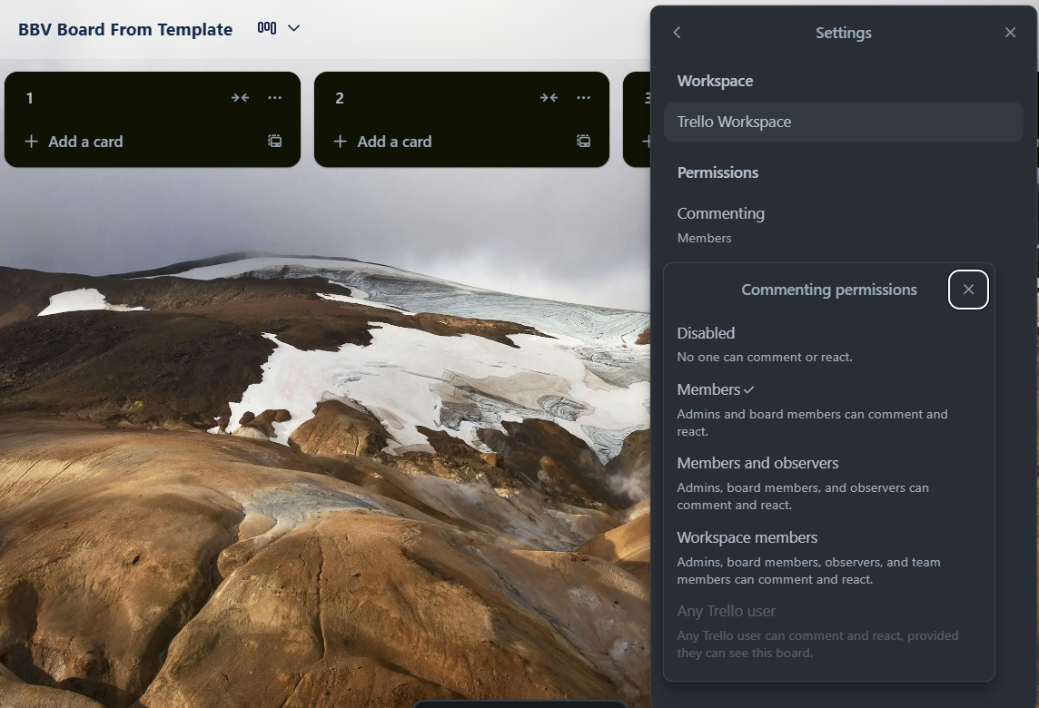
BOARD SETTING IN TRELLO SYSTEM
SettingKey
SettingValue
SettingOption

Slide 19
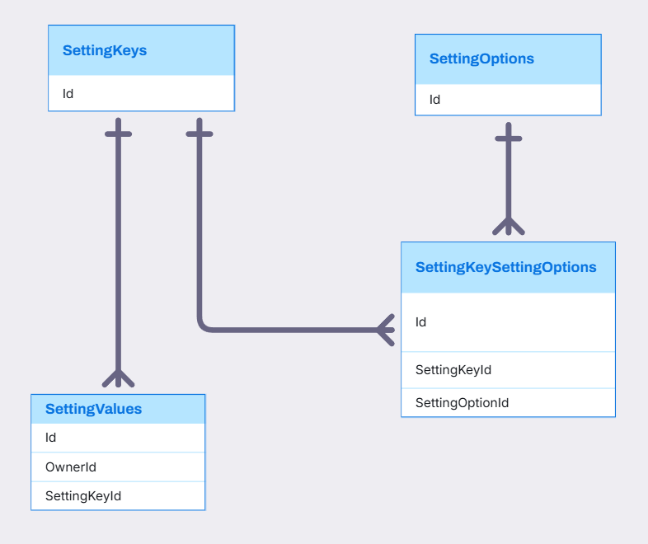
SETTINGKEY, SETTINGOPTION, SETTINGVALUE, SETTINGKEYSETTINGOPTION RELATIONSHIP

Slide 20
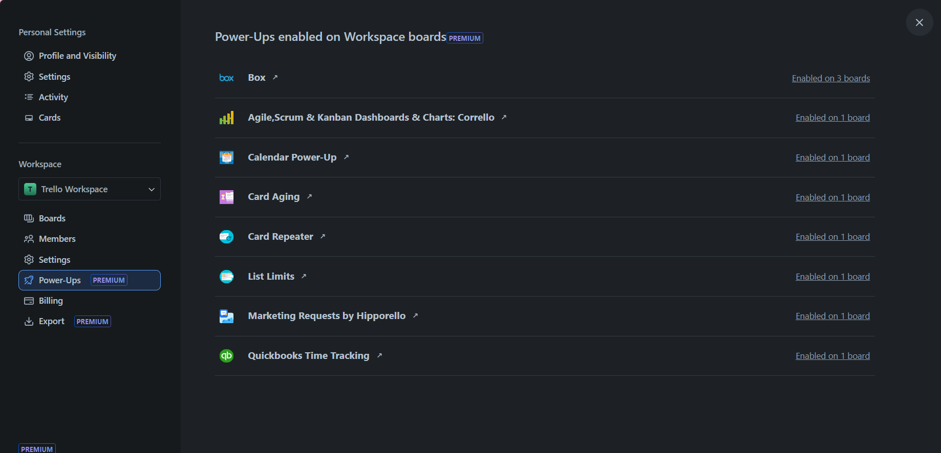
WORKSPACE IN TRELLO SYSTEM
Power-up

Slide 21
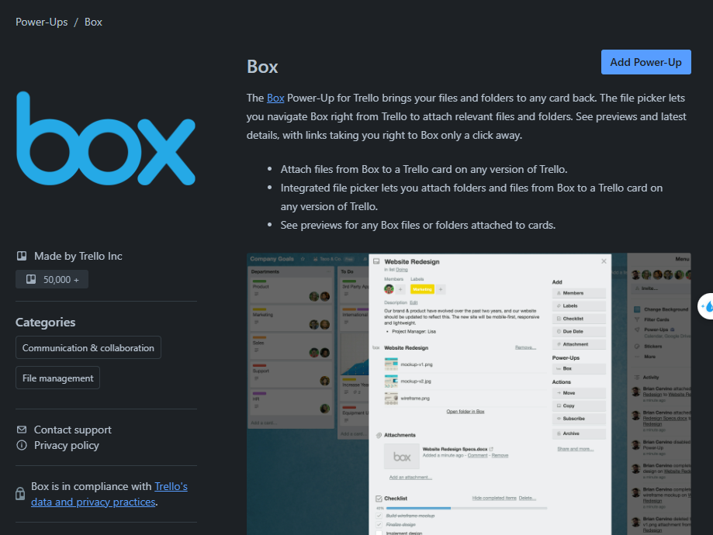
WORKSPACE IN TRELLO SYSTEM
Title
Description
AuthorName
PowerUpsCategory

Slide 22
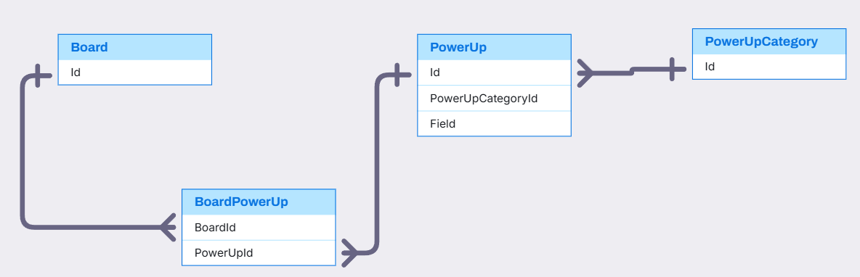
BOARD, POWERUP,POWERUPCATEGORY RELATIONSHIP
PowerUp,PowerUpCategory,Board(Quan)

Slide 23
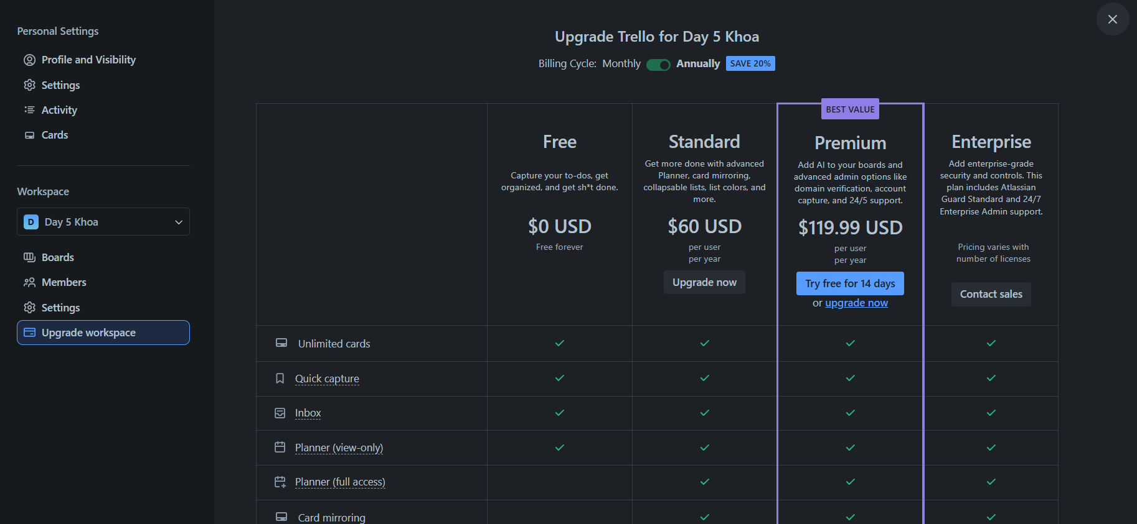
WORKSPACE IN TRELLO SYSTEM
BillingPlan
Notes:
Home Page on the Workspace page → Upgrade section, list all available billing plans that the workspace can upgrade to.

Slide 24
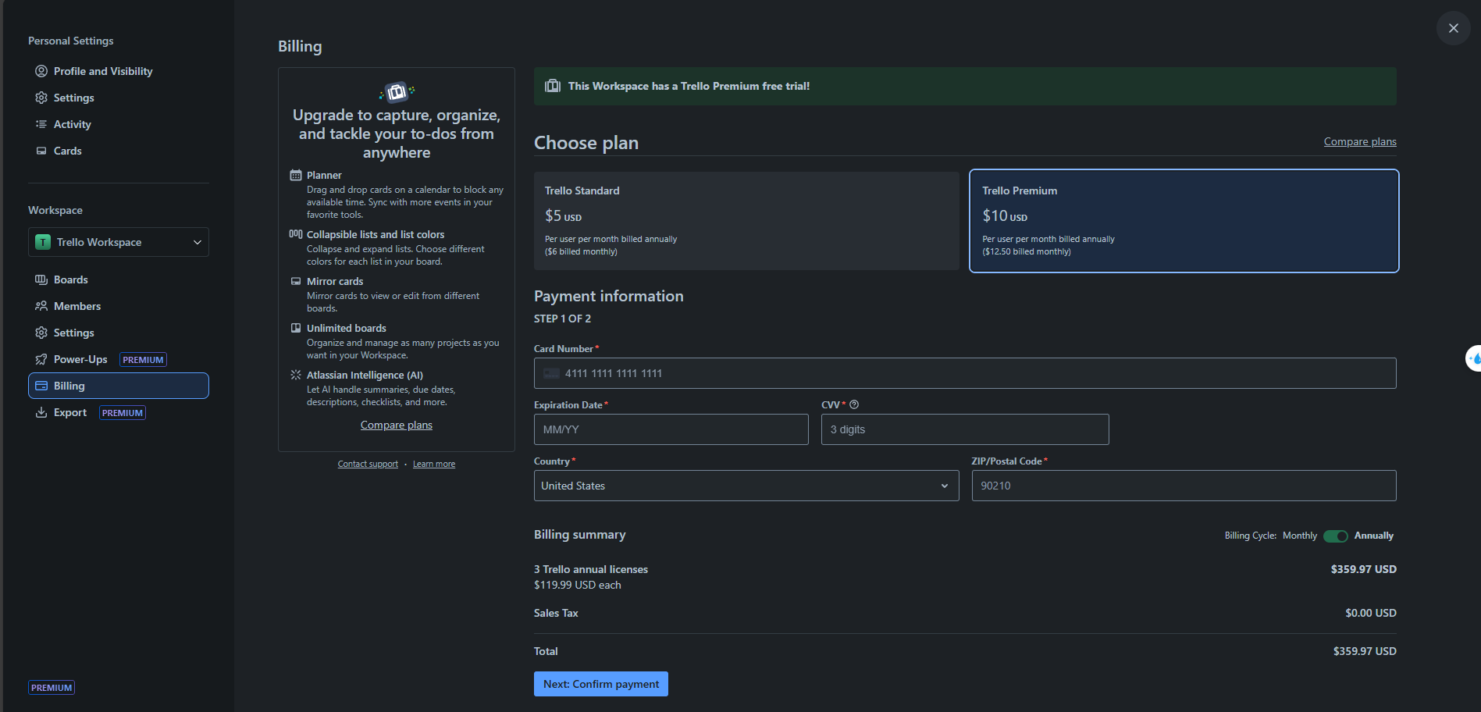
WORKSPACE IN TRELLO SYSTEM
BillingPlan
PaymentInformation
Notes:
Home Page on the Workspace page → Upgrade section, list all available billing plans that the workspace can upgrade to.

Slide 25
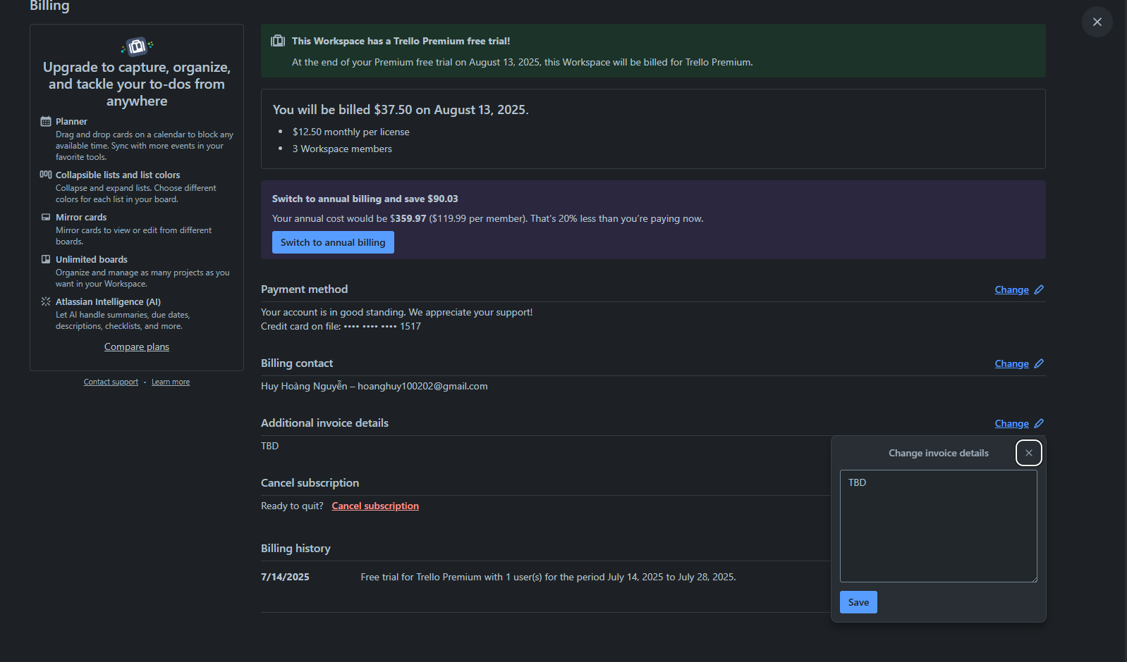
BILLING IN TRELLO SYSTEM
Billing.AdditionalInvoiceDetail

Slide 26
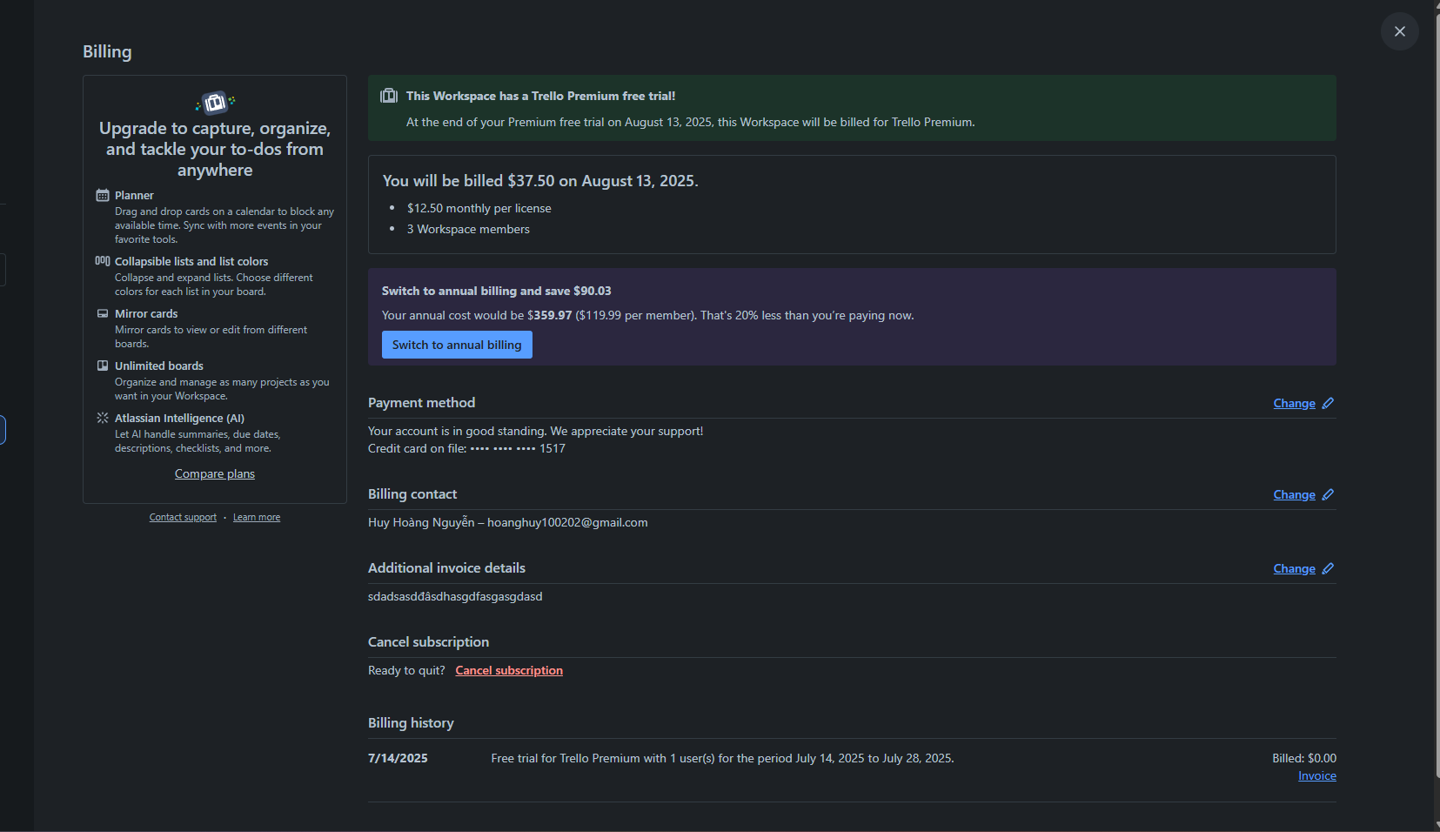
BILLING IN TRELLO SYSTEM
Subscription
Billing.AdditionalInvoiceDetail
Query from subscription

Slide 27
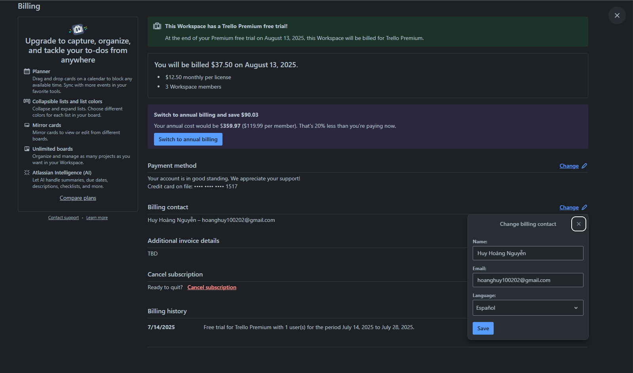
BILLING IN TRELLO SYSTEM
BillingContact

Slide 28
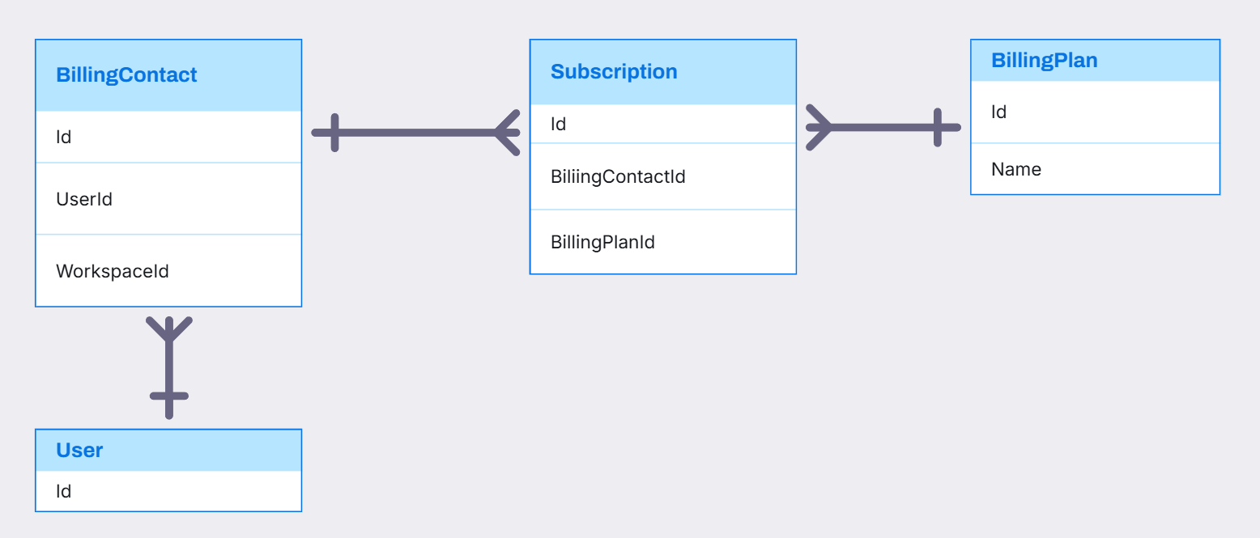
BILLINGCONTACT, BILLINGPLAN, SUBSCRIPTION RELATIONSHIP

Slide 29
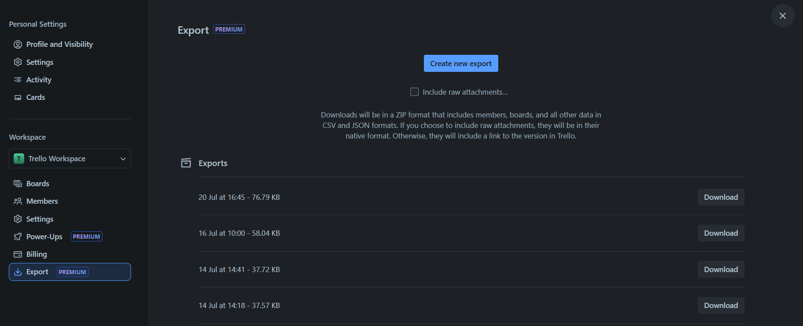
WORKSPACE IN TRELLO SYSTEM
Export

Slide 30
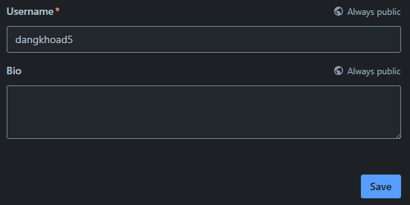
USER IN TRELLO SYSTEM
Username
UserBio

Slide 31
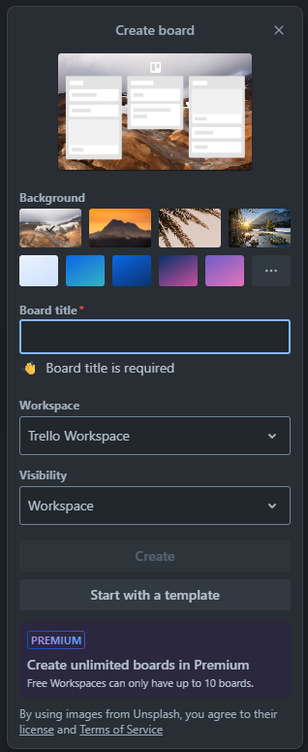
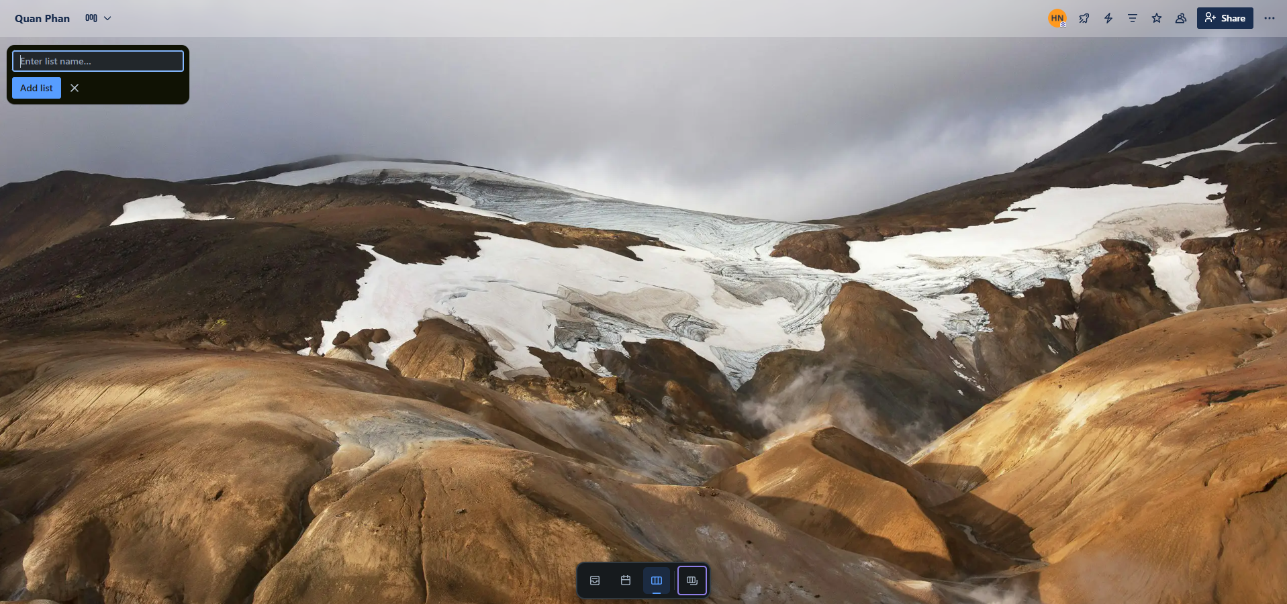
BOARD IN TRELLO SYSTEM
Stage
Board

Slide 32
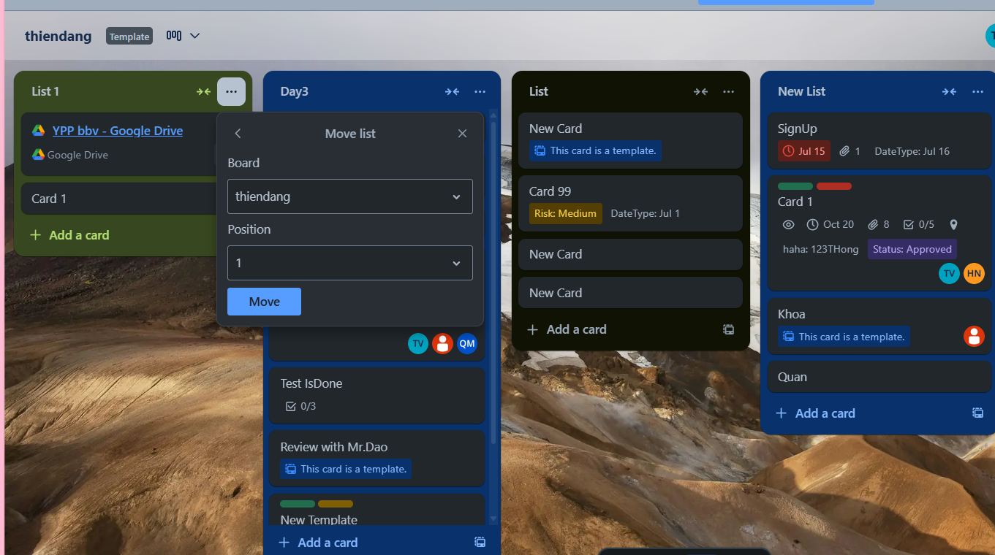
STAGE IN TRELLO SYSTEM
Stage Position

Slide 33
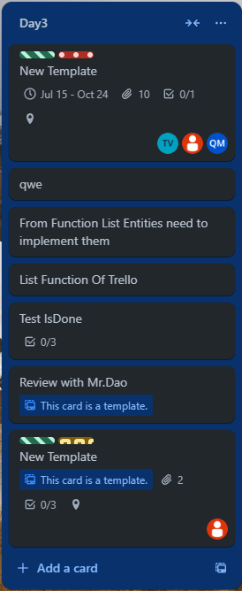
STAGE IN TRELLO SYSTEM
Stage
Card

Slide 34
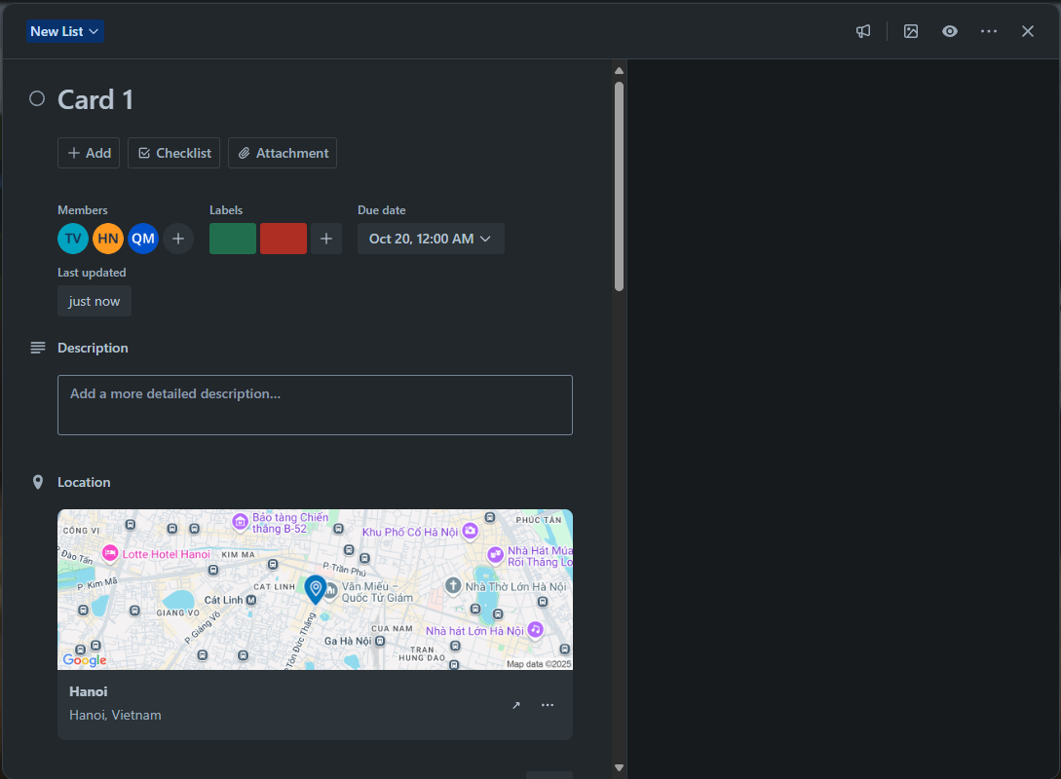
CARDS IN TRELLO SYSTEM
CardAssignMember
CardDate
Label
CardDescription
CardLocation

Slide 35
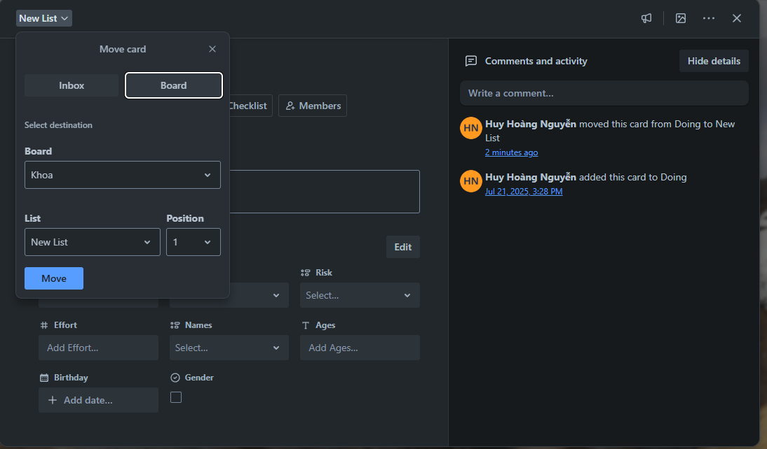
CARDS IN TRELLO SYSTEM
Card Comment
Card Position

Slide 36
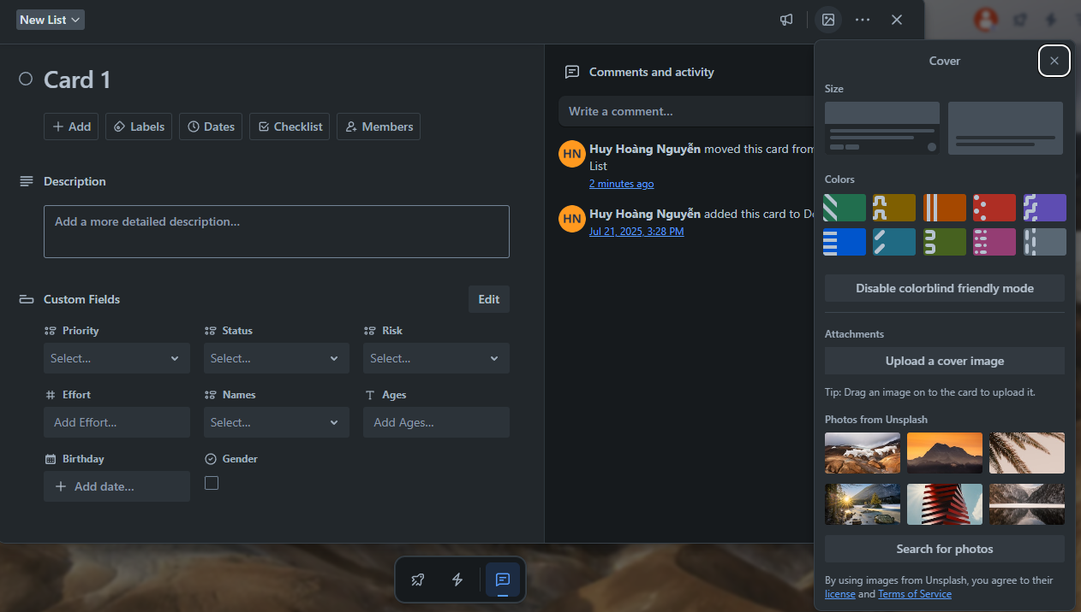
CARDS IN TRELLO SYSTEM
Color
Attachment
Card Cover
UnsplashImg

Slide 37
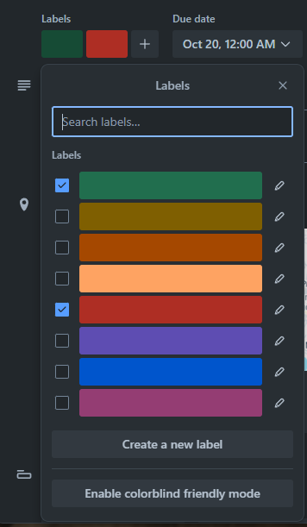
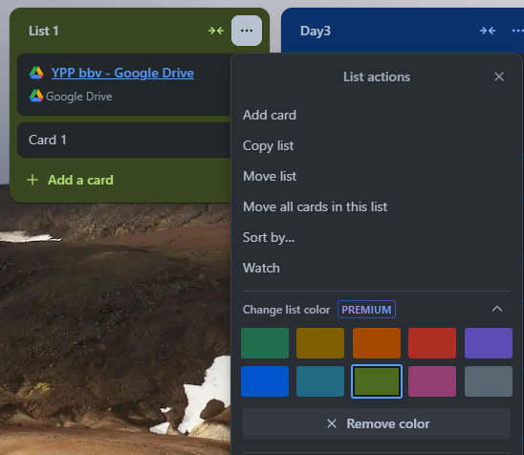
LABEL AND COLOR IN TRELLO SYSTEM
Label
Color

Slide 38
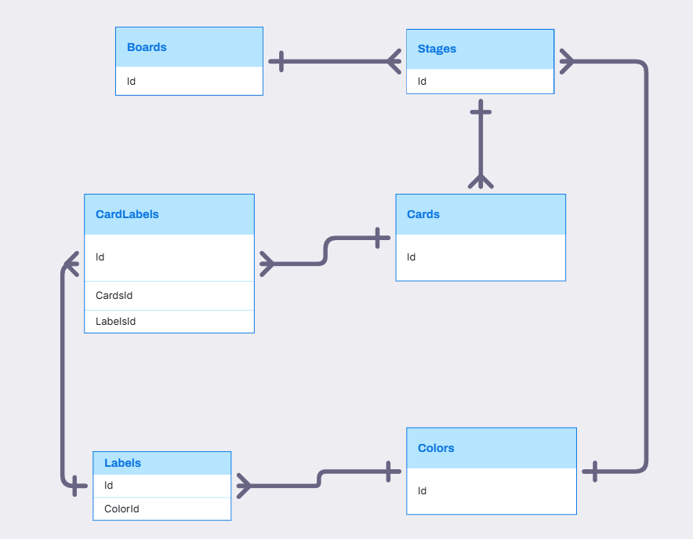
BOARD, STAGE, CARD, LABEL, COLOR RELATIONSHIP

Slide 39
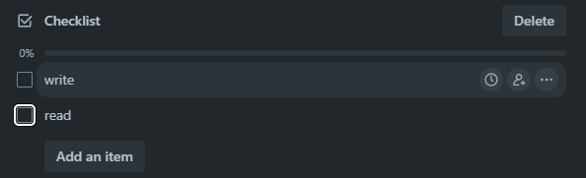
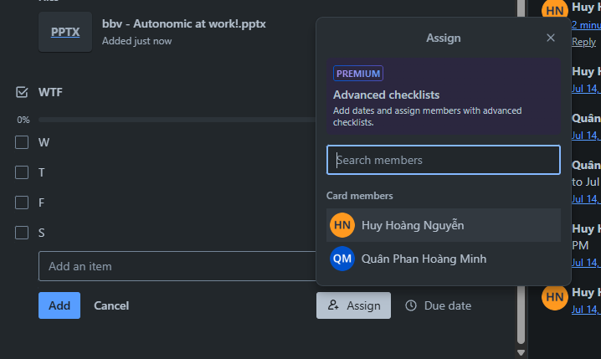
CHECKLIST IN TRELLO SYSTEM
CheckListItem
CheckList
Assign Member Into CheckListItem

Slide 40
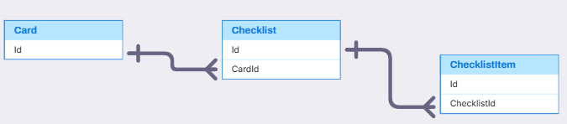
CARD, CHECKLIST, CHECKLISTITEM
Card, CheckList, CheckListItem(Quân)
,
,

Slide 41
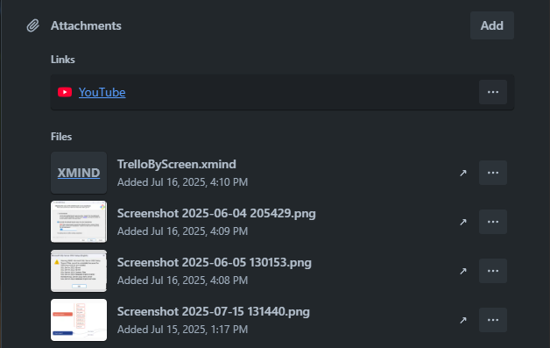
ATTACHMENT IN TRELLO SYSTEM
Attachment

Slide 42
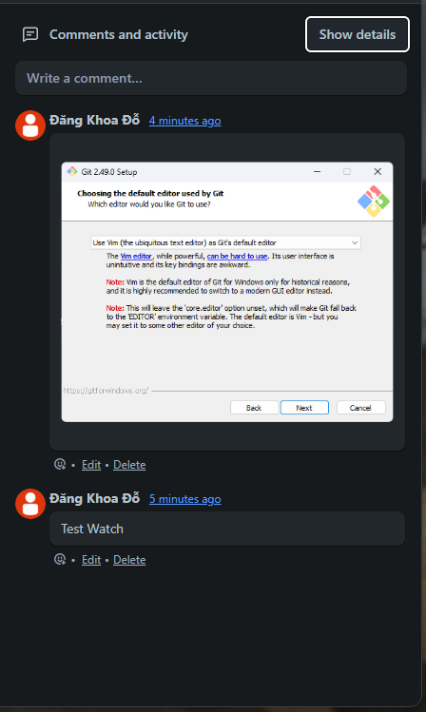
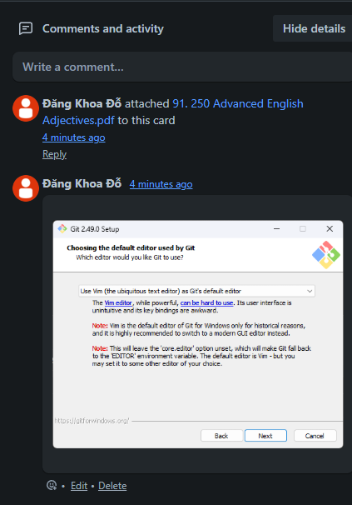
COMMENT IN TRELLO SYSTEM
Activity
Comment

Slide 43
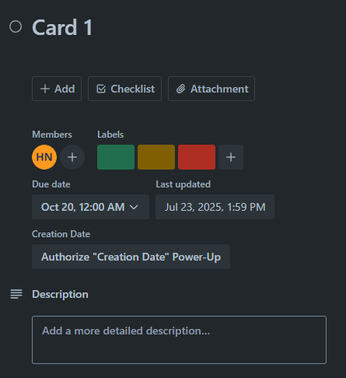
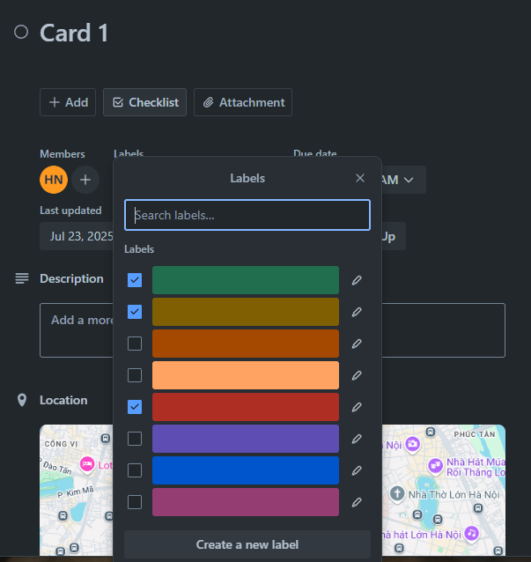
COMMENT IN TRELLO SYSTEM
Label
Label

Slide 44
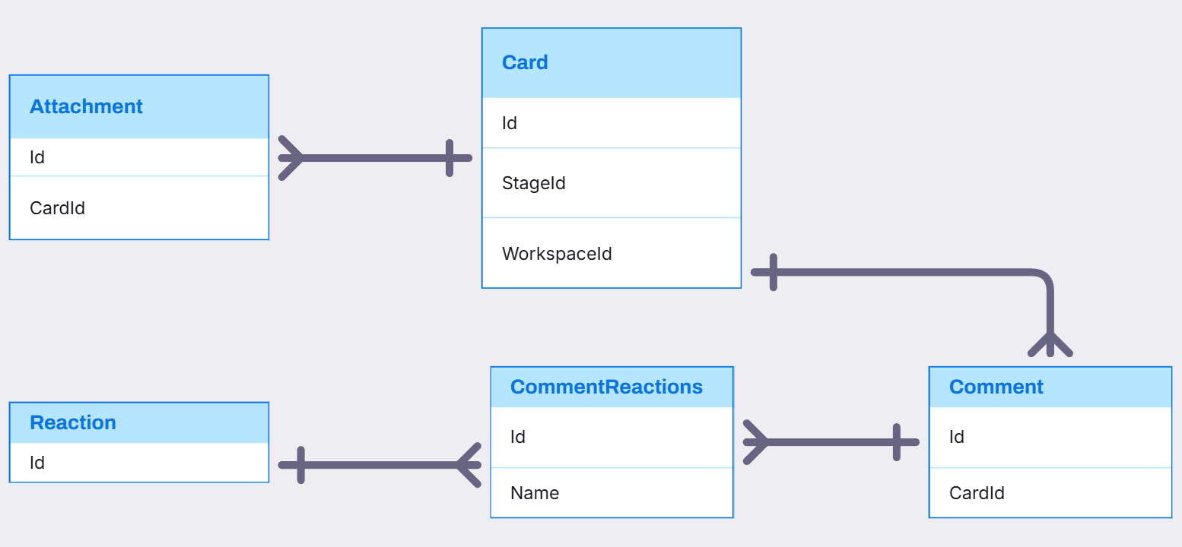
CARD, ATTACHMENT, COMMENT, REACTION RELATIONSHIP

Slide 45


CARDS IN TRELLO SYSTEM
FieldItem
CustomField
FieldValue
FieldItem

Slide 46

Visily
Card, CustomField, FieldValue, FieldItem(Thông)
,
,

Slide 47



STICKERS IN TRELLO SYSTEM
Click Here
Drag To Here
Sticker

Slide 48

STICKERS IN TRELLO SYSTEM

Slide 49

HOME TAB IN TRELLO SYSTEM
Activity
TemplateCategory
Template

Slide 50

NOTIFICATION IN TRELLO SYSTEM
Notification

Slide 51

ACTIVITY, NOTIFICATION RELATIONSHIP

Slide 52

COLLECTION IN TRELLO SYSTEM
Collection
Board

Slide 53

COLLECTION, BOARD, BOARDCOLLECTION RELATIONSHIP

Slide 54

Q&A
Thank you
Intern | Trello Team

Slide 56
bbv template EN
How-to guides

Slide 57


bbv Master layouts & slide library
Insert new slide
1
Click on «New Slide»
1
2
Select layout
Choose the desired layout from the pre-programmed master layouts.
2
🡪
Or select layout from slide library

Slide 58




Transfer of existing slides into the new Master
1
2
3
4
Insert original slide
Copy slide in original presentation with Ctrl+C.
In the target presentation, select the slide after which the original slide is to be inserted.
Select in the tab «Home / Paste / Use Destination Theme».
Assign slide layout
Select the inserted slide
Select the desired layout in the tab «Home / Layout».
Adjust slide manually
Check all slide contents such as text blocks, images, etc. for position and size and manually adjust them to the new layout grid.
Check design
Independently check:
Font type, sizes and font colours
Colours of graphic elements
Text alignment
Coherence of the overall picture
Important:
When transferring existing slides, always carry out all four steps.

Slide 59


Change icon colour
Approach
Notes
Select icon
In the tab «Graphics Format» under «Graphics Styles», use «Graphics Fill» to change the colour
For some icons, the colour can be changed by using «Graphics Outline» instead of «Graphics Fill».
The colour cannot be changed if an icon is inserted as a picture. In this case, after selecting the icon, the tab «Picture Format» appears instead of «Graphics Format».
Best vector file format for icons: *.svg

Slide 60






Insert image into placeholder
Insert image from external source
Click on the image icon, select image from Sharepoint or other source
The bbv image library is here locally located: C:\Users\Public\bbv_templates\Marketing\PPT-Bibliotheken\Bilder-Bibliothek
Or: copy image from external source with Ctrl+C, select the placeholder, then paste with Ctrl+V
Adjust
Select the image
Click in the tab «Picture Format» on «Crop»
Adjust the image composition by moving the image
Resize the image by clicking and dragging the outer circles.
Click again on «Crop» to finish the adjustments

Slide 61






Insert image into mock-up screen (mobile/laptop)
Mock-up
Paste image
Copy image from external source with Ctrl+C and paste with Ctrl+V
Image mask
Adjust size & determine image area:
Place image behind image mask
Adjust image size and determine image area
Image mask
Crop image to image mask
Select image
Select image mask
Click in the tab «Shape Format / Merge Shapes» on «Intersect»
Combine image with mock-up
Place image behind mock-up
Activate image and mock-up and align both horizontally (Align Center) and vertically (Align Middle)
Group image and mock-up with Ctrl+G

Slide 62
bbv template EN
Style guide

Slide 63



Working area, guides & ruler
Working area
Depending on the slide, a single-column layout, a 2-column or 3-column layout is used.
Display the ruler and guides in the «View» tab.

Slide 64


bbv colour theme
Always OK!
Never, please!
Default text colours
Main accent
Colours for diagrams, charts, graphs etc.
Use selectively and sparingly
Never, please!
Colours for diagrams, charts, graphs etc.
Colours for diagrams, charts, graphs etc.

